Slide 1
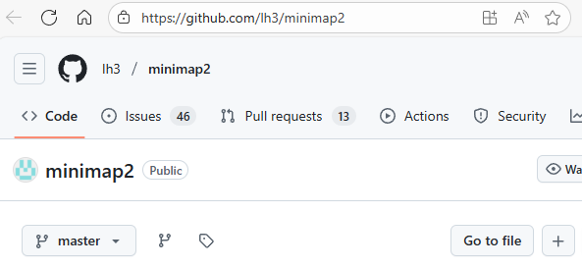
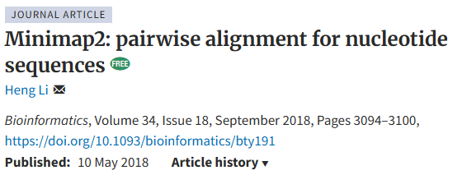
Alignment programs
Minimap2
based on minimizers

Slide 2
minimap2
minimap2 is a very fast aligner primarily useful for alignment of noisy long reads to the genome
Uses minimizers to seed alignments (k=15, w=10 by default)
Useful undocumented parameter: --secondary=no
Outputs Pairwise mApping Format (PAF) format by default, can output SAM format

Slide 3
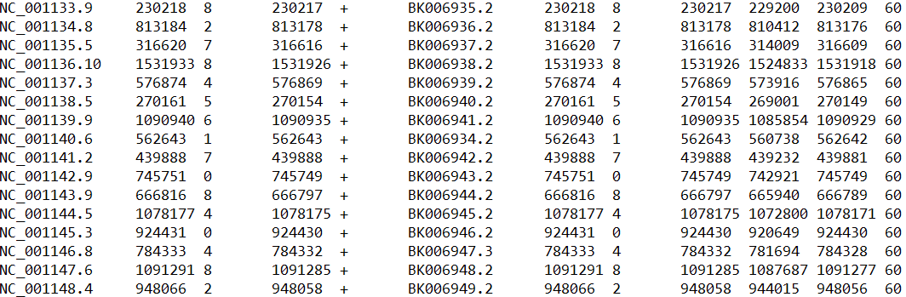
PAF format
Produced by minimap2, 0-based
If the first two bases of a read align then coordinates are (0 2)
Query Q_len Q_start Q_end Q_strand Reference R_len R_start R_end #_res bl_len MAP_Q

Slide 4
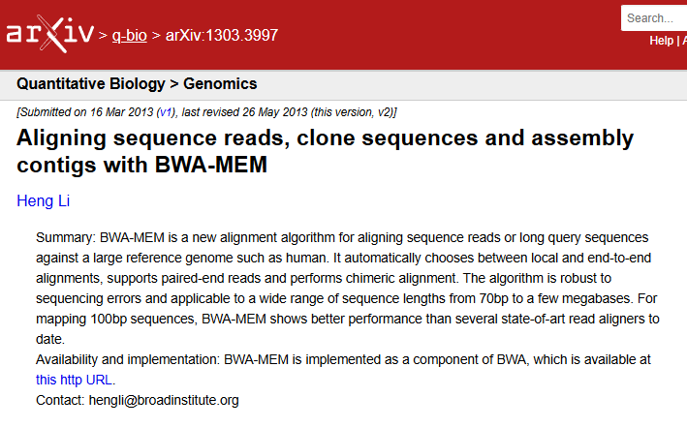
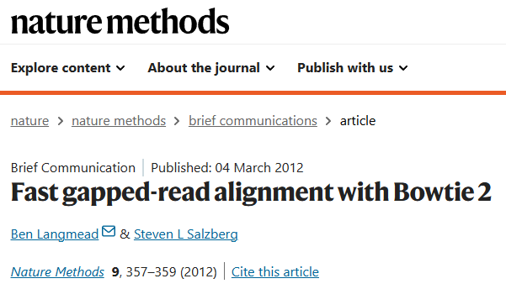
Alignment programs
Bowtie and BWA MEM
Used for alignment of short and long reads (BWA only) to the genome
Both based on BWT/SA

Slide 5
Alignment file formats
BED (Browser Extensible Data) – a nice format to represent alignment intervals
SAM/BAM – typically used for alignments of short reads to the genomic sequence
BAM is the compressed version of SAM
delta/coords – typically used for alignments of two genome sequences, used by mummer package
PAF – Pairwise mApping Format, output by minimap2

Slide 6
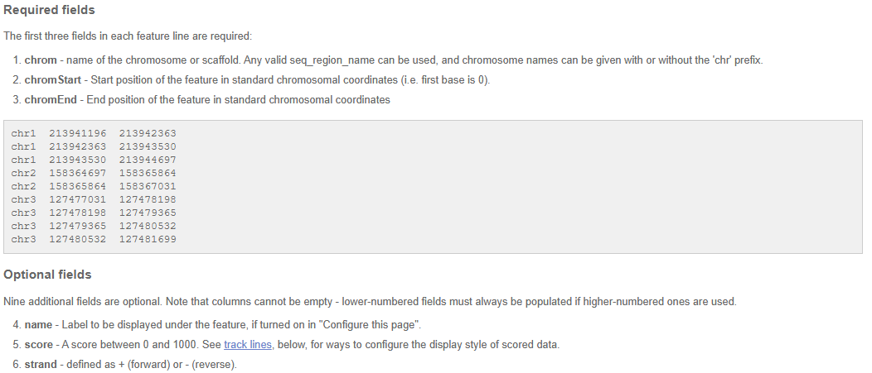
BED format
Source: https://useast.ensembl.org/info/website/upload/bed.html

Slide 7
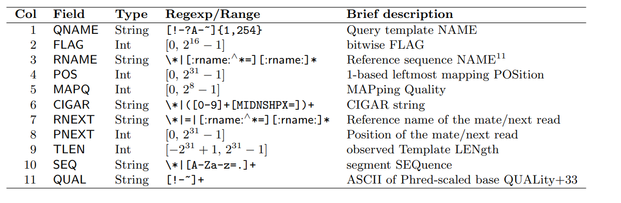
SAM format
Tab-separated file, human readable with the following columns
Missing or not defined values are *

Slide 8
SAM format
Tab-separated file, human readable with the following columns
Missing or not defined values are *

Slide 9
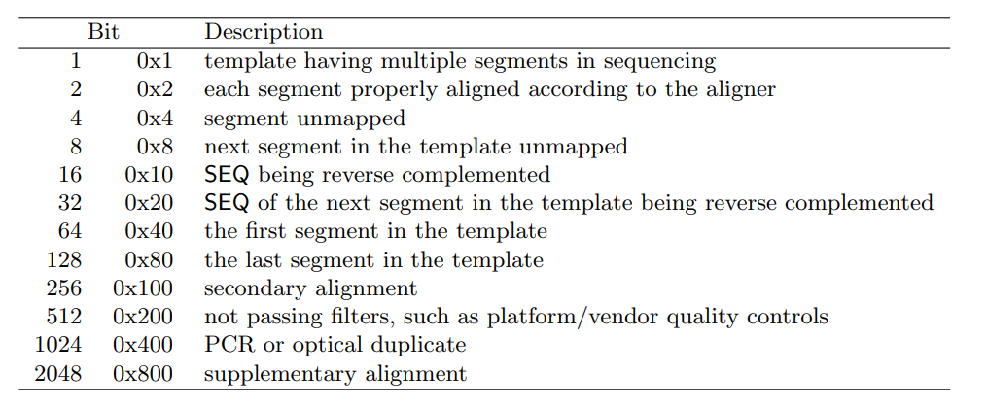
SAM format
FLAG field – 11 bits represented as decimal number
Most often used are 0, 16, and 2064
Conversion 000000010000₂ = 16

Slide 10
SAM format
Tab-separated file, human readable with the following columns
Missing or not defined values are *

Slide 11
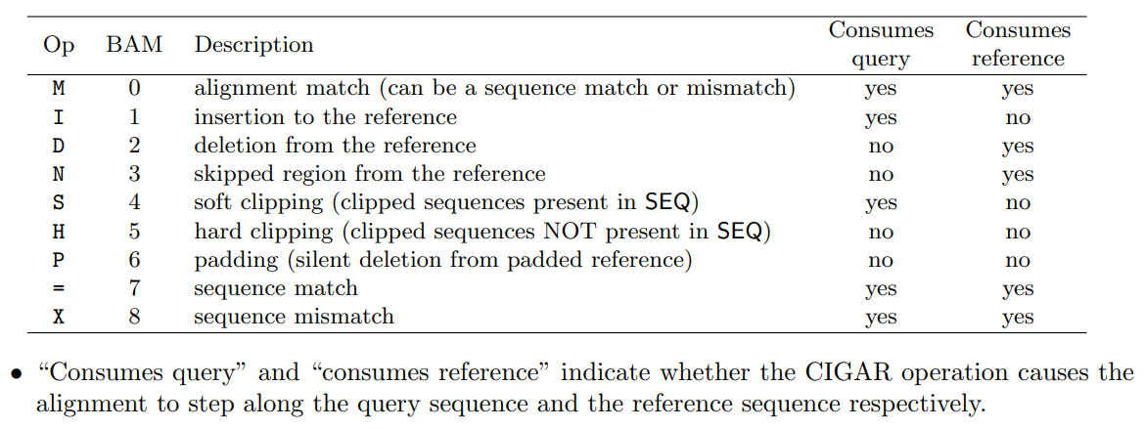
SAM format
CIGAR (Compact Idiosyncratic Gapped Alignment Report) string

Slide 12
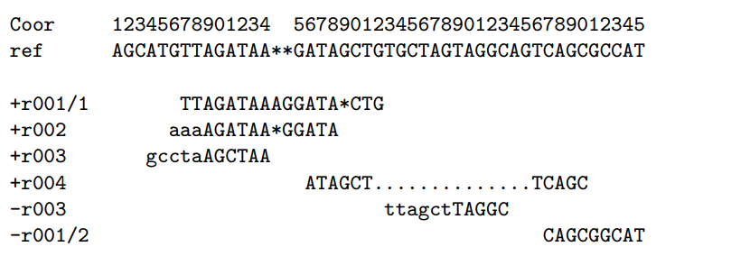
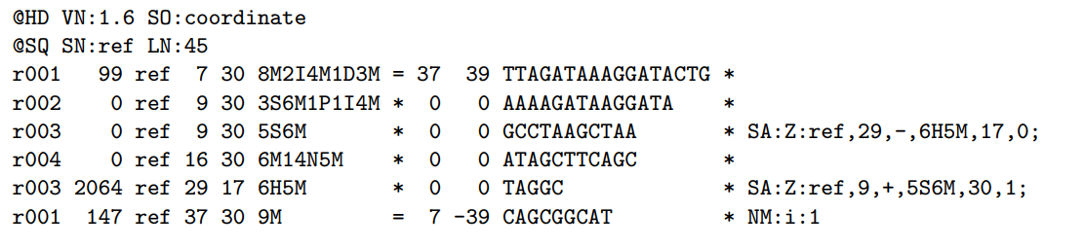
SAM format
Examples of CIGAR strings

Slide 13
SAM format https://samtools.github.io/hts-specs/SAMv1.pdf
Suppose we have the following alignment
It will look like this in the SAM file
Coordinates are 1-based

Slide 14
SAM format https://samtools.github.io/hts-specs/SAMv1.pdf
Suppose we have the following alignment
It will look like this in the SAM file
Coordinates are 1-based

Slide 15
SAM format https://samtools.github.io/hts-specs/SAMv1.pdf
Suppose we have the following alignment
It will look like this in the SAM file
Coordinates are 1-based

Slide 16
SAM format https://samtools.github.io/hts-specs/SAMv1.pdf
Suppose we have the following alignment
It will look like this in the SAM file
Coordinates are 1-based

Slide 17
SAM format https://samtools.github.io/hts-specs/SAMv1.pdf
Suppose we have the following alignment
It will look like this in the SAM file
Coordinates are 1-based

Slide 18
SAM format https://samtools.github.io/hts-specs/SAMv1.pdf
Suppose we have the following alignment
It will look like this in the SAM file
Coordinates are 1-based

